Slide 1
K-MEANS CLUSTERING

Slide 2
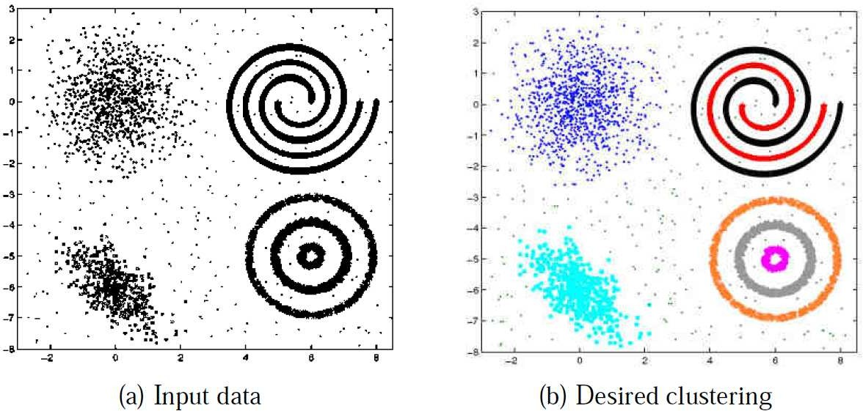
Clustering is an unsupervised learning problem
Given: N unlabeled examples {x₁, . . . , x_{N} }; the number of partitions K
Goal: Group the examples into K partitions
Similarity between examples
A good clustering is one that achieves:
High within-cluster similarity
Low inter-cluster similarity

Slide 3
Clustering?
The classification of objects into different groups, or more precisely, the partitioning of a data set into subsets (clusters), so that the data in each subset (ideally) share some common trait - often according to some defined distance measure.

Slide 4
Types
Hierarchical algorithms: these find successive clusters
using previously established clusters.
Partitional clustering: Partitional algorithms determine all clusters at once. They include:
  K-means and derivatives
  Fuzzy c-means clustering
  QT clustering algorithm

Slide 5
Distance measures
Distance measure will determine how the similarity of two elements is calculated and it will influence the shape of the clusters.
Choice of the similarity measure is very important for clustering
Similarity is inversely related to distance
Different ways exist to measure distances. Some examples:
Manhattan distance – Find equation
Euclidean distance – Find equation

Slide 6
K-MEANS CLUSTERING
The k-means algorithm is an algorithm to cluster n objects based on attributes into k partitions, where k < n.
Simply speaking k-means clustering is an algorithm to classify or to group the objects based on attributes/features into K number of group.
K is positive integer number.
The grouping is done by minimizing the sum of squares of distances between data and the corresponding cluster centroid.

Slide 7

How the K-Mean Clustering algorithm works?

Slide 8

K=2

Slide 9


Step 1:
Initialization: Randomly we choose following two centroids (k=2) for two clusters.
In this case the 2 centroid are: m1=(1.0,1.0) and m2=(5.0,7.0).

Slide 10




Step 2:
Thus, we obtain two clusters containing:
{1,2,3} and {4,5,6,7}.
Their new centroids are:

Slide 11

Step 3:
Now using these centroids we compute the Euclidean distance of each object, as shown in table.
Therefore, the new clusters are:
{1,2} and {3,4,5,6,7}
Next centroids are: m1=(1.25,1.5) and m2 = (3.9,5.1)

Slide 12

Step 4 :
The clusters obtained are:
{1,2} and {3,4,5,6,7}
Therefore, there is no change in the cluster.
Thus, the algorithm comes to a halt here and final result consist of 2 clusters {1,2} and {3,4,5,6,7}.

Slide 13

PLOT

Slide 14
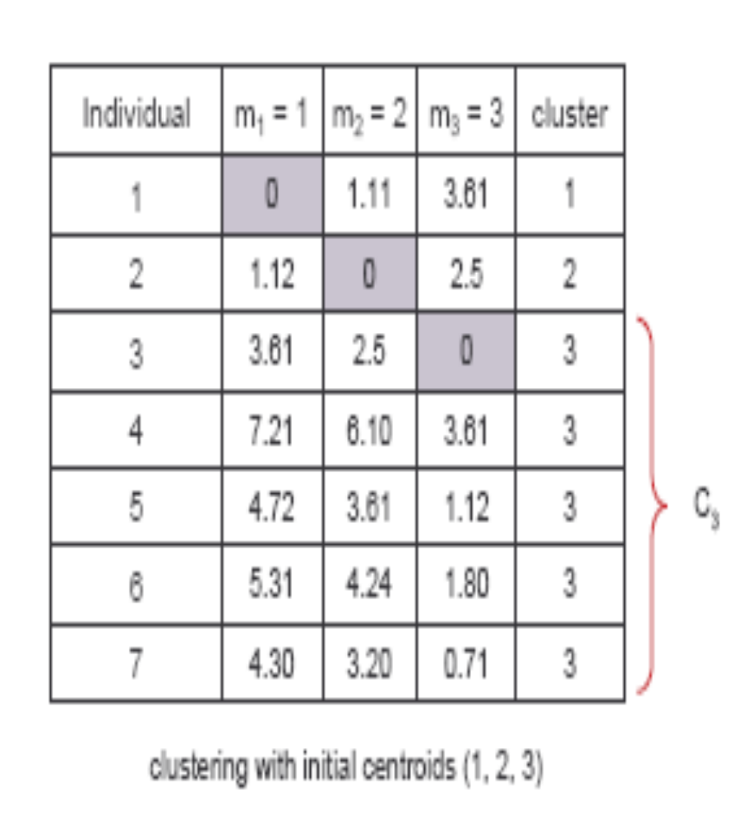
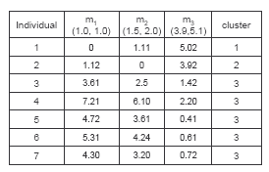
(with K=3)
Step 1
Step 2

Slide 15
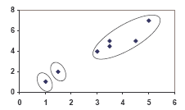
PLOT

Slide 16
Weaknesses of K-Mean Clustering
When the numbers of data are not so many, initial grouping will determine the cluster significantly.
The number of cluster, K, must be determined before hand. Its disadvantage is that it does not yield the same result with each run, since the resulting clusters depend on the initial random assignments.
We never know the real cluster, using the same data, because if it is inputted in a different order it may produce different cluster if the number of data is few.
It is sensitive to initial condition. Different initial condition may produce different result of cluster. The algorithm may be trapped in the local optimum.

Slide 17
CONCLUSION
K-means algorithm is useful for undirected knowledge discovery and is relatively simple. K-means has found wide spread usage in lot of fields, ranging from unsupervised learning of neural network, Pattern recognitions, Classification analysis, Artificial intelligence, image processing, machine vision, and many others.

